Slide 1
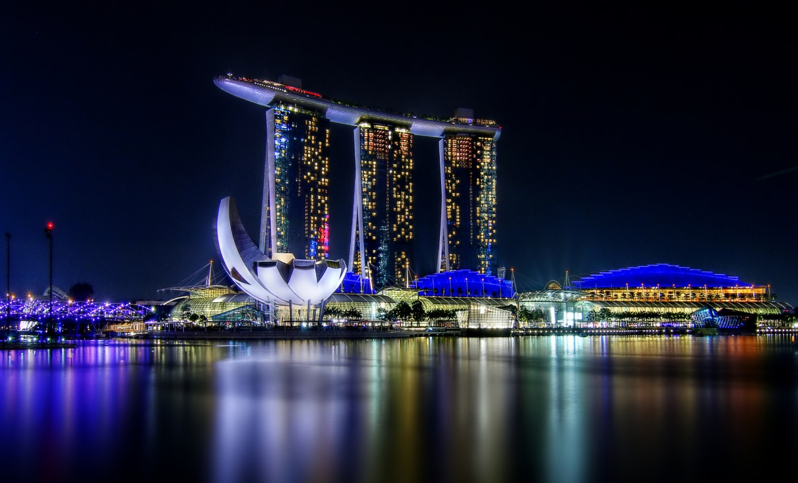
Marina Bay Sands Singapore
4_Elvia_Goh_1E2

Slide 2
IMMERSE YOURSELF IN THESE ZONES
Art Science Museum
Spa
Entertainment
Shoppes
ACCOMMODATIONS

Slide 3
ArtScience Museum
Dinosaurs: Dawn to Extinction
Get transported back to the Precambrian, Triassic, Jurassic and Cretaceous prehistoric periods in the exhibition of its kind, and relive the dinosaurs’ natural environment as you uncover how the different species lived on earth.

Slide 4
Spa
Banyan Tree Spa at Marina Bay Sands
Experience the restorative power of touch. Discover award-winning physical, mental, and spiritual renewal at Banyan Tree Spa – fifty-five storeys above the ground. Immerse yourself in an indulgent array off massages designed to soothe your senses and body.

Slide 5
Entertainment
ENTERTAINMENTS SHOW DATES
My Fair Lady 11 FEBRUARY – 2 MARCH 2014 8PM
International Jazz Festival (MAIN FESTIVAL) 28 FEBRUARY – 2 MARCH 2014 6.30PM
Rolling Stones 15 MARCH 2014 8PM
The Greatest Love Of All 4-5 APRIL 2014 8PM
Tap Dogs 27 MAY 1 JUNE 2014 (TUESDAY-FRIDAY : 7.30PM)
(SATURDAY: 2PM & 7.30PM)
(SUNDAY: 1PM & 5PM)
Grease 25 APRIL – 11 MAY 2014 8PM

Slide 6
Shoppes
CATEGORIES
→WOMEN’S FASHION
→MEN’S FASHION
→JEWELLERY
→WATCH
→LINGERIE
→HAND BAGS,SHOES & ACCESSORIES
→CHILDREN’S FASHION & MATERNITY
→LIFESTYLES & GIFTS
→ELECTRONICS & TELECOMMUNICATIONS
→GENERAL
→BAR & NIGHTCLUBS
Complementing the hotel is one of the largest collections of the world’s most coveted designer boutiques in the region.

Slide 7
Accommodations
→ DELUXE ROOM
→ PREMIER ROOM
→ CLUB ROOM
→ GRAND CLUB ROOM
→ ORCHID ROOM
→ MARINA SUITE
→ BAY SUITE
→ SANDS SUITE
→ MERLION SUITE
→ STRAITS SUITE
→ SINGAPURA SUITE
→ ISTANA SUITE
→ PRESIDENT SUITE
→ CHAIRMAN SUITE
Marina Bay Sands is the leading business, leisure and entertainment destination in Asia.

Slide 8
Click HERE more information!

